Slide 1
Week 10 – Session 1
DW 10.009 – Introduction to Python Programming

Slide 2
Week 10 Breakdown
Session 1: Introduction to Data Science
Introduction to Numpy
Core ideas about data science
Data Manipulation and Visualization
Session 2: Introduction to regression
Key parameters for regression
Linear regression
Multiple linear regression
Session 3: About classification
Key parameters for classification
K-NN Classification

Slide 3
Week 10 Breakdown
Session 1: Introduction to Data Science
Introduction to Numpy
Core ideas about data science
Data Manipulation and Visualization
Session 2: Introduction to regression
Key parameters for regression
Linear regression
Multiple linear regression
Session 3: About classification
Key parameters for classification
K-NN Classification

Slide 4
About the Numpy library
A quick tour of the key concepts and functions

Slide 5
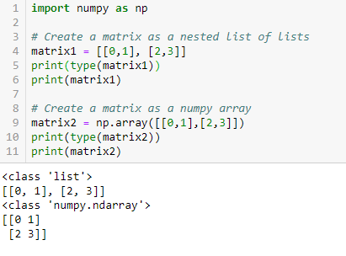
Numpy vs lists
Numpy arrays are objects from the Numpy library.
Typically used to describe matrices and vectors.
The look very similar to nested lists of lists, which we have used earlier for representing matrices.

Slide 6
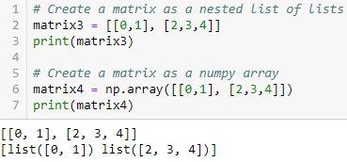
Numpy vs lists
Numpy arrays offer more tools for matrix computation.
For starters, Numpy can identify oddly-shaped matrices from the start.
Many methods from lists can be reused, but the numpy library offers more functions/methods.

Slide 7
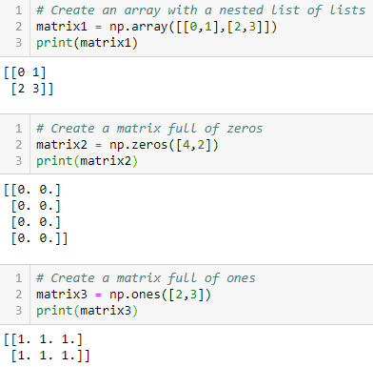
Numpy generation: array, zeros, ones
The Numpy arrays can be generated in multiple ways
We can pass a nested list of lists detailing the matrix elements.
Or we can generate matrices by specifying dimensions and fill it with zeros or ones.

Slide 8
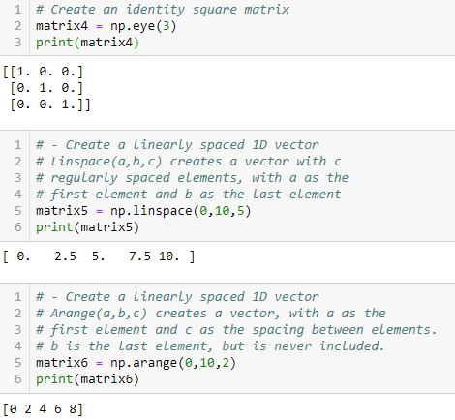
Numpy generation 2: eye ,linspace, arange
It is also possible to create square identity matrices with eye()
Or use linspace and a range functions to create vectors with regularly spaced elements.

Slide 9
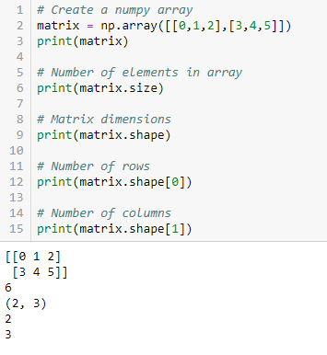
Some key attributes of Numpy: shape and size
The Numpy arrays are custom objects with some attributes.
Some interesting attributes are
Shape: contains a tuple, with the number of rows and columns of the matrix.
Size: an integer containing the number of elements in the numpy array.

Slide 10
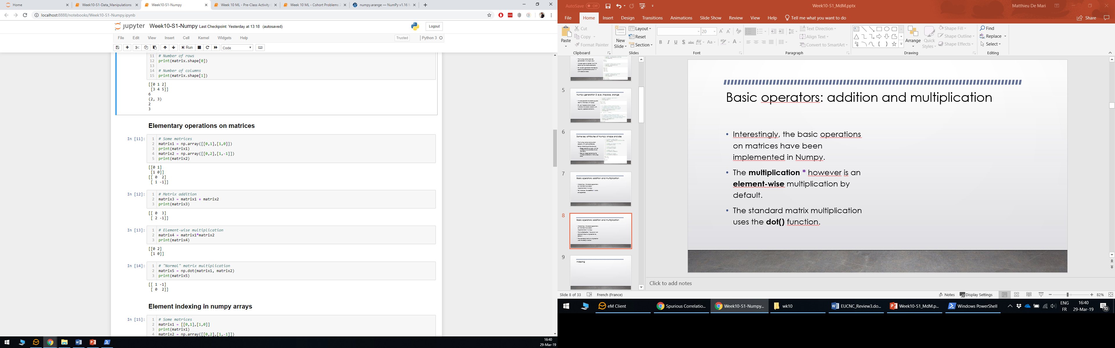
Basic operators: addition and multiplication
Interestingly, the basic operations on matrices have been implemented in Numpy.
For instance, the addition + works as expected.

Slide 11
Basic operators: addition and multiplication
Interestingly, the basic operations on matrices have been implemented in Numpy.
The multiplication * however is an element-wise multiplication by default.
The standard matrix multiplication uses the dot() function.

Slide 12
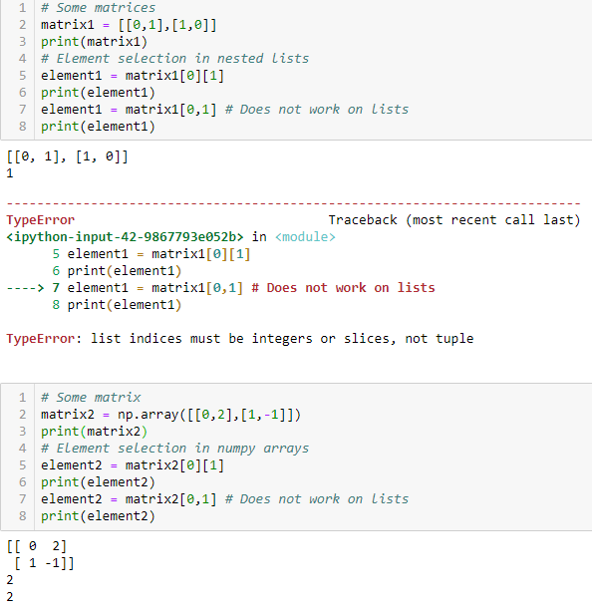
Indexing
As before with nested lists, we can perform indexing with successive brackets.
However, we can also use the bracket and comma notation on Numpy arrays.
(and it is often much prefered)

Slide 13
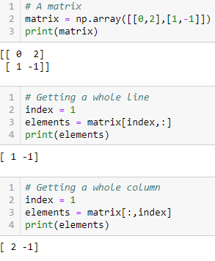
Slicing
We can also perform slicing, as before.
We can also use the : symbol to select all the elements along a dimension of the matrix
(whole row/column)

Slide 14
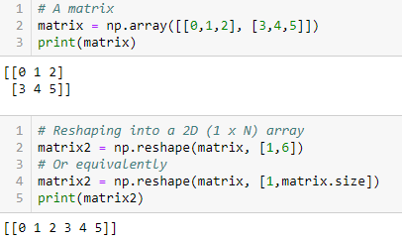
Reshaping into 1D arrays, a.k.a. flattening.
Sometimes, we might be interested to reshape our matrix into a 1D vector.
We can do so with the reshape() function.
This operation is typically known as flattening a matrix

Slide 15
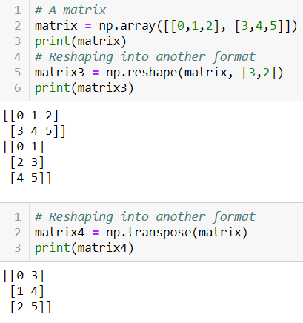
Reshaping and transposing
It can also be used to reshape a matrix from a given shape to another one.
For instance reshape a (2,3) matrix into a (3,2) matrix.
Important: this is not a transposition operation!
Transposition = transpose()

Slide 16
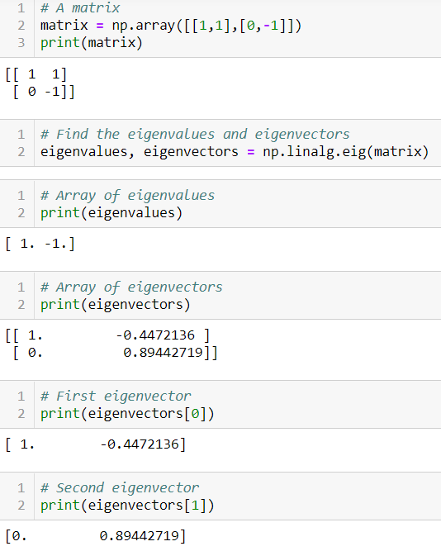
Eigenvalues and eigenvectors
Numpy also has lots of functions implementing linear algebra operations, such as
Finding eigenvalues and eigenvectors

Slide 17
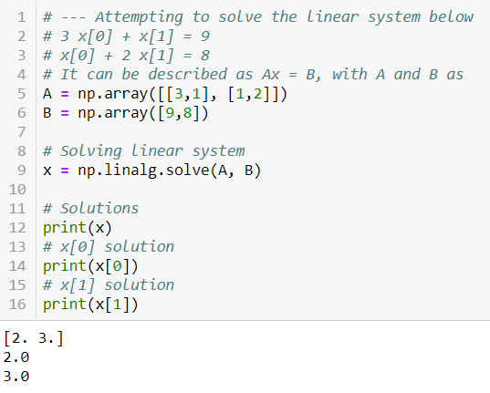
Linear system solving
Numpy also has lots of functions implementing linear algebra operations, such as
Solving a linear system of equations

Slide 18
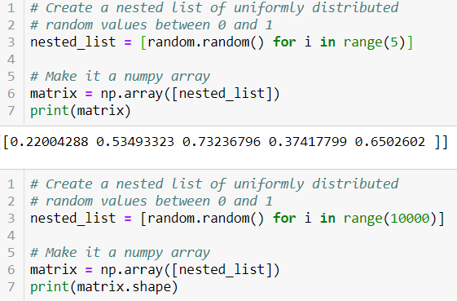
Min, Max, Mean, Median, Percentile
It has also functions for finding the
Minimal value,
Maximal value,
Mean value,
Median values,
Etc.
For any given array, containing random variables realizations.
Here, we create an array of realizations for a uniform(0,1) random variable, with the random.random() function.

Slide 19
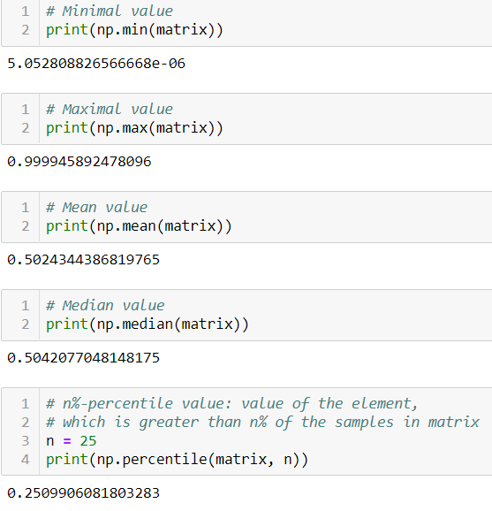
Min, Max, Mean, Median, Percentile
It has also functions for finding the
Minimal value,
Maximal value,
Mean value,
Median values,
Etc.
For any given array, containing random variables realizations.
Here, we create an array of realizations for a uniform(0,1) random variable, with the random.random() function.

Slide 20
Conclusion: Numpy
Numpy is a powerful library for matrix and vector calculations, typically used in data science.
More info about its possibilities, here: https://www.numpy.org/devdocs/user/quickstart.html
Also has some math functions: np.cos, np.sin, np.log, etc.
Also has some random functions: np.random.randint
More linear algebra functions: rank of a matrix, determinant of a matrix, inversion of a matrix, diagonalization of a matrix, etc.

Slide 21
A quick introduction to data science
We will see more about these typical problems in Sessions 2 and 3.

Slide 22
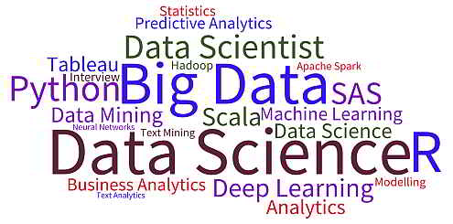
A quick introduction to data science
Data science has been recently trending, with many keyswords…
But what is the core idea behind this data science concept?

Slide 23
A quick introduction to data science
Data science has been recently trending, with many keyswords…
But what is the core idea behind this data science concept?
Core ideas
make sense from data
and learn information from it.

Slide 24
Core idea behind data science: find the missing function, based on available data
What we have done in Programming so far was to design functions,
which would do specific operations
and return outputs
for any input we could give it
Input (given)
Function
(Created)
Output
(Obtained)

Slide 25
Core idea behind data science: find the missing function, based on available data
What we have done in Programming so far was to design functions,
which would do specific operations
and return outputs
for any input we could give it
But sometimes, we can encounter problems where
we can easily find inputs and expected outputs,
but the function to be coded is not simple to figure out.
Input (given)
Function
(Created)
Output
(Obtained)
Input (available)
Function
(?)
Output
(available)

Slide 26
Core idea behind data science: find the missing function, based on available data
What we have done in Programming so far was to design functions,
which would do specific operations
and return outputs
for any input we could give it
But sometimes, we can encounter problems where
we can easily find inputs and expected outputs,
but the function to be coded is not simple to figure out.
Idea: What if the computer could learn the function on its own?
Input (given)
Function
(Created)
Output
(Obtained)
Input (available)
Function
(?)
Output
(available)

Slide 27
A typical example
Inputs x | Outputs y
1 | 1
2 | 4
3 | 9
4 | 16
5 | 25
7 | 49
8 | 64
9 | 81
10 | 100
For instance, if I were to give you this table of values…

Slide 28
A typical example
Inputs x | Outputs y
1 | 1
2 | 4
3 | 9
4 | 16
5 | 25
6 | ?
7 | 49
8 | 64
9 | 81
10 | 100
For instance, if I were to give you this table of values…
And then ask you to guess the expected output for the value 6…

Slide 29
A typical example
Inputs x | Outputs y
1 | 1
2 | 4
3 | 9
4 | 16
5 | 25
6 | ?
7 | 49
8 | 64
9 | 81
10 | 100
For instance, if I were to give you this table of values…
And then ask you to guess the expected output for the value 6…
You would probably guess, it is 36.

Slide 30
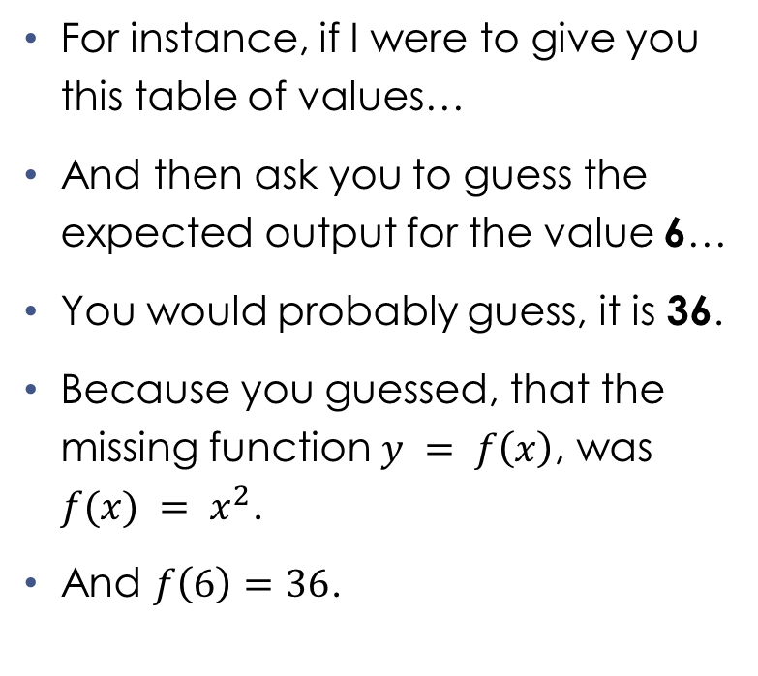
A typical example
Inputs x | Outputs y
1 | 1
2 | 4
3 | 9
4 | 16
5 | 25
6 | ?
7 | 49
8 | 64
9 | 81
10 | 100
For instance, if I were to give you this table of values…
And then ask you to guess the expected output for the value 6…
You would probably guess, it is 36.
Because you guessed, that the missing function $y = f\left(x\right)$, was $f(x) = x^{2}$.
And $f\left(6\right)=36$.

Slide 31
Record/Experience, features/inputs and labels/outputs
Inputs x | Outputs y
1 | 1
2 | 4
3 | 9
4 | 16
5 | 25
7 | 49
8 | 64
9 | 81
10 | 100
6 | ?
What just happened?

Slide 32
Record/Experience, features/inputs and labels/outputs
Inputs x | Outputs y
1 | 1
2 | 4
3 | 9
4 | 16
5 | 25
7 | 49
8 | 64
9 | 81
10 | 100
6 | ?
What just happened?
You used your previous experience/record
Experience/Record

Slide 33
Record/Experience, features/inputs and labels/outputs
Inputs x | Outputs y
1 | 1
2 | 4
3 | 9
4 | 16
5 | 25
7 | 49
8 | 64
9 | 81
10 | 100
6 | ?
What just happened?
You used your previous experience/record
To “guess” what might be the relationship/function f
Between your inputs/features x
And their respective outputs/labels y
Experience/Record
Input x (available)
Function f
(?)
Output y = f(x)
(available)

Slide 34
About regression
That is a very common problem in data science, called regression.

Slide 35
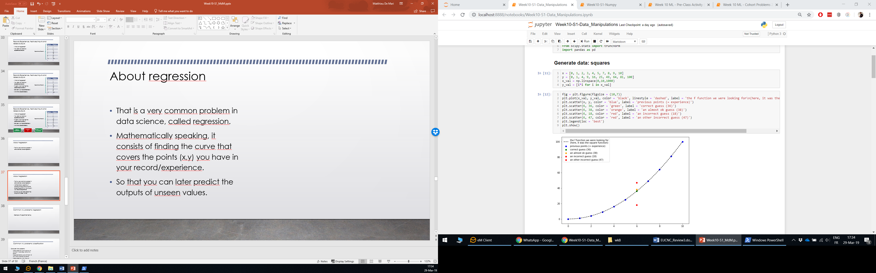
About regression
That is a very common problem in data science, called regression.
Mathematically speaking, it consists of finding the curve that covers the points (x,y) you have in your record/experience.
So that you could later predict the outputs of unseen input values.

Slide 36
Typical problems in regression
Inputs x | Outputs y
1 | 1
2 | 4
3 | 9
4 | 16
5 | 25
7 | 49
8 | 64
9 | 81
10 | 100
6 | ?
Typically, our squares example

Slide 37
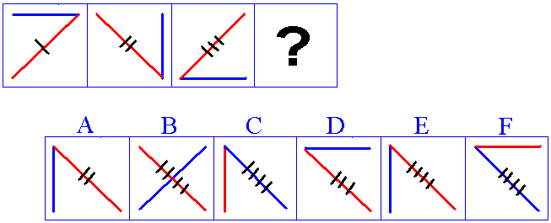
Typical problems in regression
Inputs x | Outputs y
1 | 1
2 | 4
3 | 9
4 | 16
5 | 25
7 | 49
8 | 64
9 | 81
10 | 100
6 | ?
Typically, our squares example
The IQ tests: « guess the element that comes next in the sequence »

Slide 38

Typical problems in regression
Inputs x | Outputs y
1 | 1
2 | 4
3 | 9
4 | 16
5 | 25
7 | 49
8 | 64
9 | 81
10 | 100
6 | ?
Typically, our squares example
The IQ tests: « guess the element that comes next in the sequence »
Exemple with appartment selling
Guessing the selling price of an appartment based on its size and your previous sales.

Slide 39
Typical problems in regression
Inputs x | Outputs y
1 | 1
2 | 4
3 | 9
4 | 16
5 | 25
7 | 49
8 | 64
9 | 81
10 | 100
6 | ?
Typically, our squares example
The IQ tests: « guess the element that comes next in the sequence »
Exemple with appartment selling
Guessing the selling price of an appartment based on its size and your previous sales.
Etc.

Slide 40
Regression and classification
Regression problems are very common in real-life.
Other very common problems are classification ones.
Input x (available)
Function f
(?)
Output y = f(x)
(available)

Slide 41

Regression and classification
Regression problems are very common in real-life.
Other very common problems are classification ones.
Typically used in computer vision.
Input x (available)
Function f
(?)
Output y = f(x)
(available)
Very easy for a human…
It’s a cat!

Slide 42
Regression and classification
Regression problems are very common in real-life.
Other very common problems are classification ones.
Typically used in computer vision.
Input x (available)
Function f
(?)
Output y = f(x)
(available)
Very easy for a human…
How would we do it with a computer?
It’s a cat!

Slide 43
Classification are very common in computer vision
Computer vision problems:
Image recognition: given a picture, tell me what it is (cats/dogs, name of the person)
It’s a cat!

Slide 44
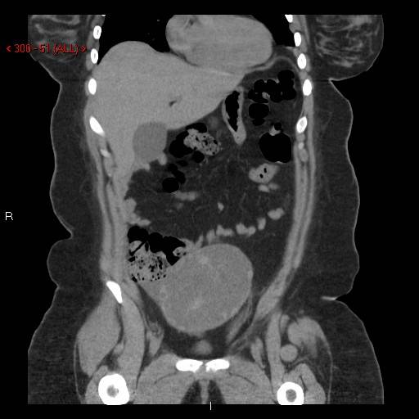
Classification are very common in computer vision
Computer vision problems:
Image recognition: given a picture, tell me what it is (cats/dogs, name of the person)
Image classification: given a CT scan, tell me if there is a cancer/not cancer
That’s
cancerous

Slide 45
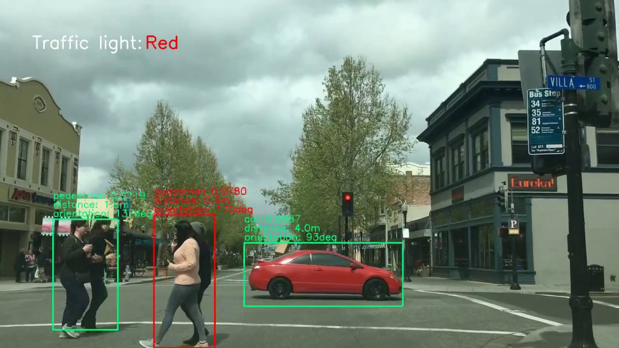
Classification are very common in computer vision
Computer vision problems:
Image recognition: given a picture, tell me what it is (cats/dogs, name of the person)
Image classification: given a CT scan, tell me if there is a cancer/no cancer
Image recognition + segmentation:
find if there is a pedestrian in the picture
and if so, where he/she is,
And what its movement is.

Slide 46
Recap for data science
Many real-life problems
will fall in either the regression or the classification category
and can be addressed with data science based approaches.
We will cover a typical regression problem on Session 2.
And a typical classification problem on Session 3.

Slide 47
Recap for data science
Many real-life problems
will fall in either the regression or the classification category
and can be addressed with data science based approaches.
We will cover a typical regression problem on Session 2.
And a typical classification problem on Session 3.
But before we do so, a quick word about data visualization.

Slide 48
About data visualization
Looking for ideas, by exploring your data.

Slide 49
Seeking inspiration by visualizing data
Often, in data science problems, we like to plot the data to see what the problem looks like.

Slide 50
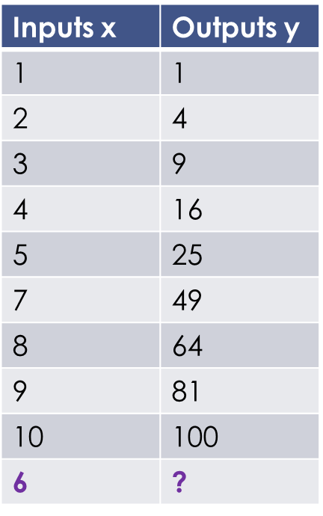
Seeking inspiration by visualizing data
Often, in data science problems, we like to plot the data to see what the problem looks like.
For instance, we could have plotted the points of the square problem discussed earlier…
And recognized that the missing function we were looking for was most likely a quadratic function of some sort.

Slide 51
Seeking inspiration by visualizing data
Size (in sqm) | Price (in $)
57 | 544000
76 | 760000
92 | 947000
101 | 1006000
101 | 1049000
106 | 1037000
… | …
Let us say I have a table of previous appartment sales…
Containing a list of appartments I have sold in the past, with their size (in sqm) and their price (in $)

Slide 52
Seeking inspiration by visualizing data
Size (in sqm) | Price (in $)
57 | 544000
76 | 760000
92 | 947000
101 | 1006000
101 | 1049000
106 | 1037000
… | …
Let us say I have a table of previous appartment sales…
Containing a list of appartments I have sold in the past, with their size (in sqm) and their price (in $).
And friend comes and asks for an estimation of the price of its 125sqm appartment. What is your answer?

Slide 53
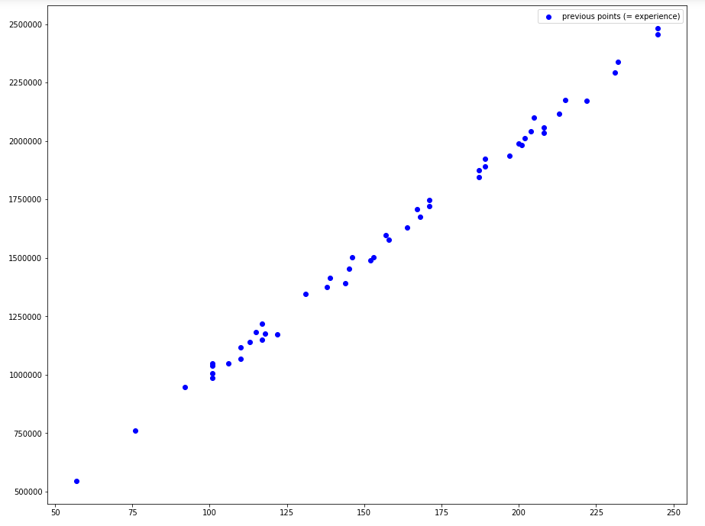
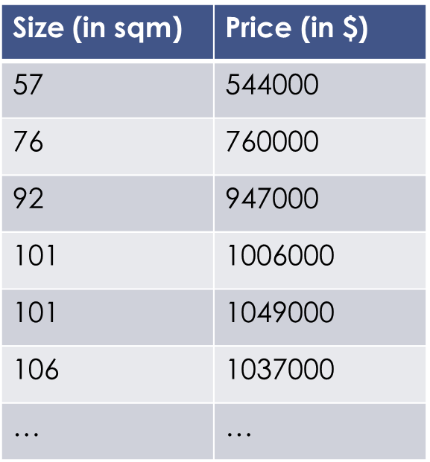
Seeking inspiration by visualizing data
Let us say I have a table of previous appartment sales…
Containing a list of appartments I have sold in the past, with their size (in sqm) and their price (in $)
And friend comes and asks for an estimation of the price of its 125sqm appartment. What is your answer?

Slide 54
Scatter plots
Scatter plots are often useful.
They give rough insights as to what the function linking my inputs and outputs might be.

Slide 55
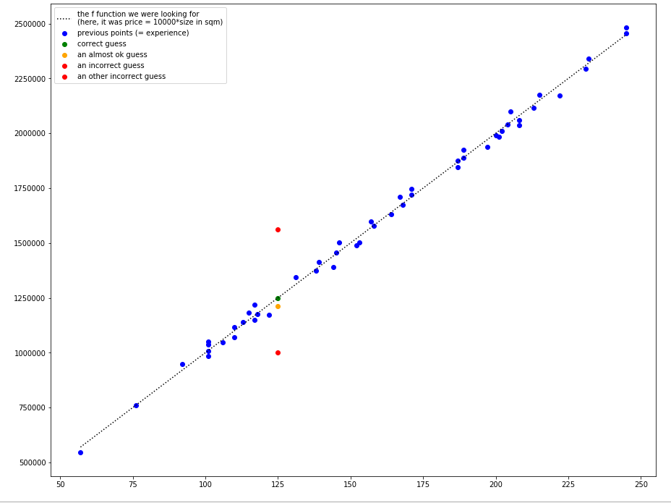
Scatter plots
Scatter plots are often useful.
They give rough insights as to what the function linking my inputs and outputs might be.

Slide 56
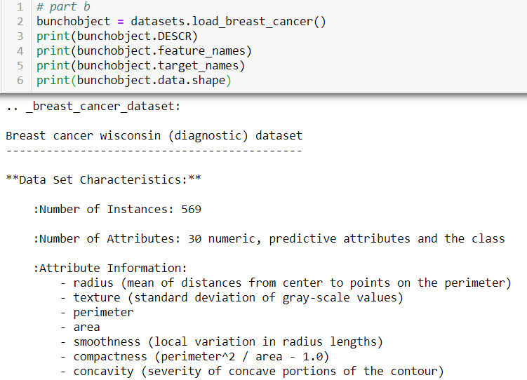
Using data descriptors
Data descriptors are also very useful.
They give a numerical recap of key values of the data (its min, max, mean, median, etc.)
Data objects often have built-in descriptors, but their name may vary.

Slide 57
Seeking inspiration by visualizing data
Size (in sqm) | Price (in $)
57 | 544000
76 | 760000
92 | 947000
101 | 1006000
101 | 1049000
106 | 1037000
… | …
Let us say I have a table of previous appartment sales…
Containing a list of appartments I have sold in the past, with their size (in sqm) and their price (in $).
And friend comes and asks for an estimation of the price of its 125sqm appartment. What is your answer?

Slide 58
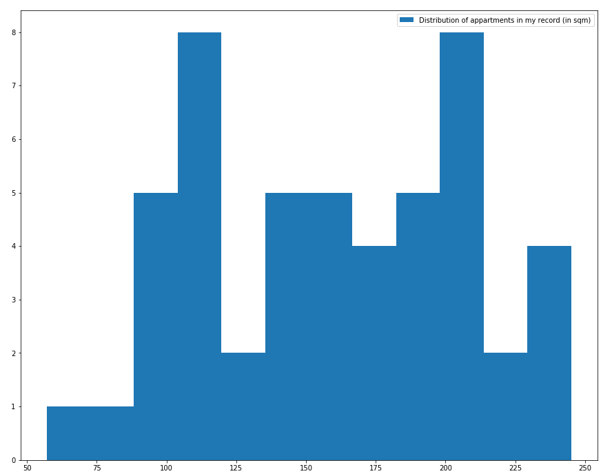
Histogram plots
Histograms are also useful, in order to visualize the distribution of the appartments you have in your record.

Slide 59
Histogram plots
Histograms are also useful, in order to visualize the distribution of the appartments you have in your record.
Price for a 110sqm appartment?
→ Confident, I have seen a lot of those

Slide 60
Histogram plots
Histograms are also useful, in order to visualize the distribution of the appartments you have in your record.
Price for a 110sqm appartment?
→ Confident, I have seen a lot of those
Price for a 500sqm appartment?
→ Have never seen those before…

Slide 61
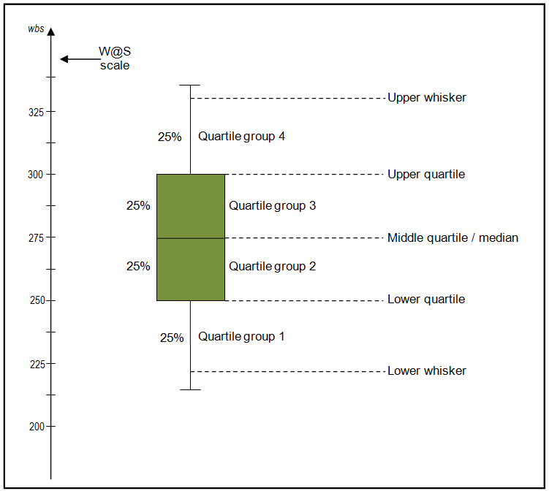
Boxplots
Boxplots can also be used to get information about the data distribution.
They more or less do the same thing as the histogram plots and five-number summaries.

Slide 62
Let us practice a bit
Problem set 10 – Q1, Q2 & Q3 (confusion matrix, 5-number summary and normalization)

Slide 63
Q1: Confusion matrix and precision metrics
In this activity, let us assume we have designed a computer vision AI, attempting to recognize images of birds/cats.
We have two lists.
The first one, named actual, contains what really is in the image (bird or cat)
The second one, named predicted, contains what our AI identified in the images.
Step 1: define a confusion matrix, listing the number of right guesses and mistakes, as described in Q1.
Step 2: define some key precision metrics (recall, accuracy, false positive rate) for our AI.

Slide 64
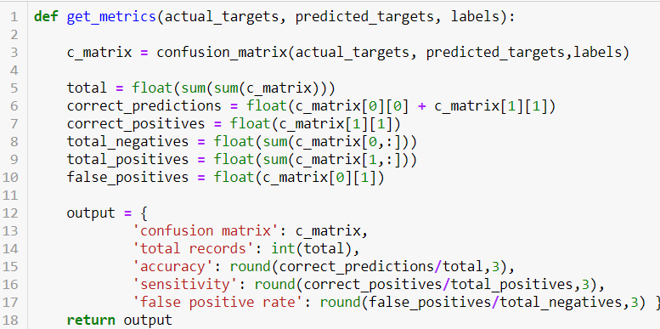
Q1: Confusion matrix and precision metrics
Extra challenge: write your own confusion matrix function!

Slide 65
Let us practice a bit
Problem set 10 – Q1, Q2 & Q3 (confusion matrix, 5-number summary and normalization)

Slide 66
Q2: Five-number summary
The five-number summary, is an informative function about data, listing
The minimal value in a given array
The maximal value in a given array
The median value in a given array
The first quarter percentile value in a given array
The third quarter percentile value in a given array

Slide 67
For Q2: Min, Max, Mean, Median, Percentile
Numpy has functions for finding the
Minimal value,
Maximal value,
Mean value,
Median values,
Etc.
For any given array, containing data.

Slide 68
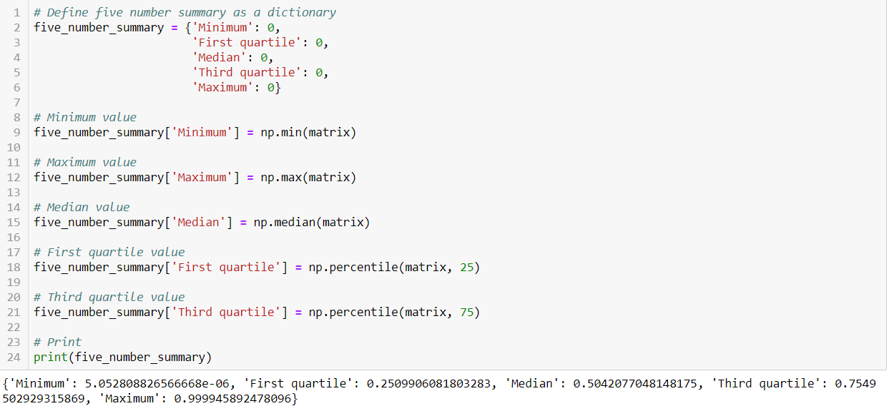
Five-number summary

Slide 69
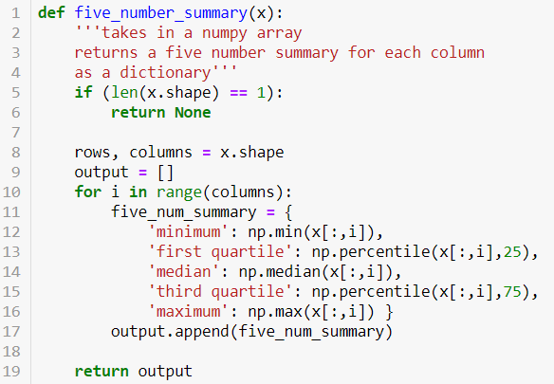
Five-number summary

Slide 70
Let us practice a bit
Problem set 10 – Q1, Q2 & Q3 (confusion matrix, 5-number summary and normalization)

Slide 71
Q3: data normalization
Input x1 | Input x2
1 | 10
2 | 6
3 | 2
4 | 4
5 | 0
Data normalization is a typical operation in Machine Learning.
It re-scales the data, so that the minimal value in the data will become 0.
And the maximal value will become 1.
Input x1 (normalized) | Input x2 (normalized)
0 | 1
0.25 | 0.6
0.5 | 0.2
0.75 | 0.4
1 | 0

Slide 72
Q3: data normalization
Input x1 | Input x2
1 | 10
2 | 6
3 | 2
4 | 4
5 | 0
Data normalization is a typical operation in Machine Learning.
It re-scales the data, so that the minimal value in the data will become 0.
And the maximal value will become 1.
Q3: write a function that receives a data array, and normalize the columns of the array one-by-one.
Input x1 (normalized) | Input x2 (normalized)
0 | 1
0.25 | 0.6
0.5 | 0.2
0.75 | 0.4
1 | 0

Slide 73
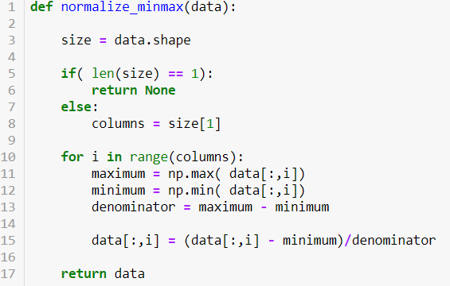
Q3: data normalization
Data normalization is a typical operation in Machine Learning.
It re-scales the data, so that the minimal value in the data will become 0.
And the maximal value will become 1.
Q3: write a function that receives a data array, and normalize the columns of the array one-by-one.

Slide 74
Conclusion
Data manipulation and visualization is the first thing to do when encountering a data science problem.
It usually gives us good insights
as to what the data consists of,
how the data is distributed,
and sometimes, even gives us a clear linear/polynomial trend that we can reuse!
On the next session, we will discuss linear/polynomial regression and classification problems.

Slide 75
Bonus
Some extra stuff and discussions

Slide 76
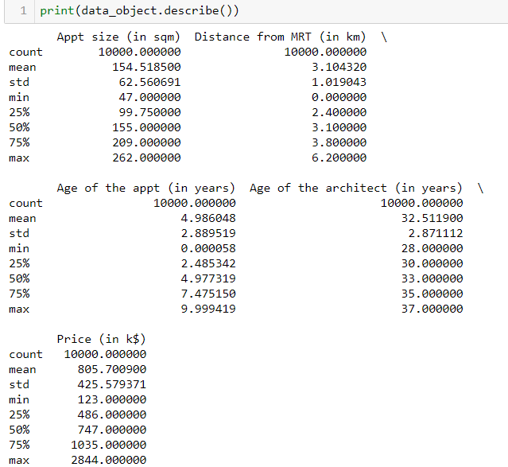
More powerful plots for complex data
Let us reconsider the appartment problem.
Our objective: guess the selling price of the appartment, given a list of features about the appartment (its size, etc.)
Now we have more features, than just the size.

Slide 77
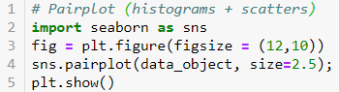
Pairplot (histograms + scatter)
The seaborn library gives more powerful plots (and works with matplotlib)
The pairplot gives scatter plots between all the columns of data in your dataset, as well as histograms for the repartition of data.

Slide 78
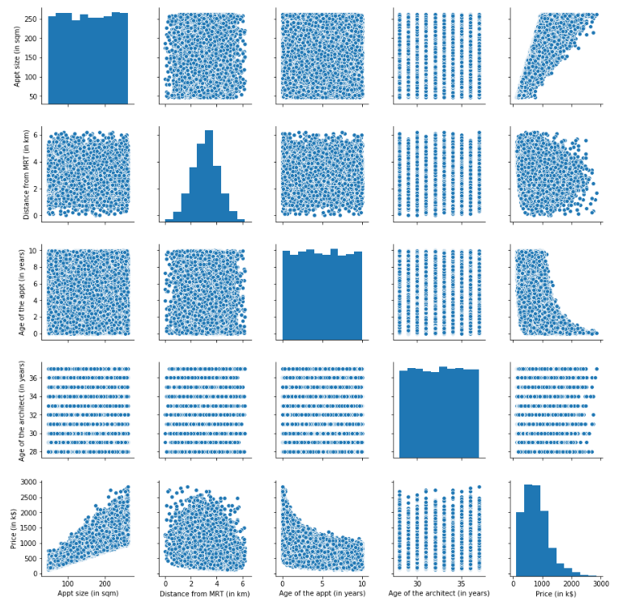

Slide 79
Correlation matrix
Another useful tool, to highlight possible relationships between data is the correlation.
That is a measure telling how close two columns of values seem to behave.
Correlation between to columns of values X1 and X2 gives a value between -1 and 1

Slide 80
Correlation matrix
If Corr(X1, X2) ≈ 0
there does not appear to be a clear relationship between X1 and X2.
If Corr(X1, X2) > 0.1
X1 seems to increase when X2 increases as well.
The higher the value of Corr(X1, X2), the more explicit this trend is.
If Corr(X1, X2) < -0.1
X1 seems to decrease when X2 increases as well.
The lower the value of Corr(X1, X2), the more explicit this trend is.
Another useful tool, to highlight possible relationships between data is the correlation.
That is a measure telling how close two columns of values seem to behave.
Correlation between to columns of values X1 and X2 gives a value between -1 and 1

Slide 81
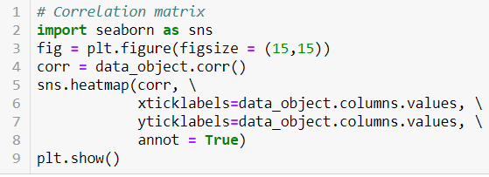

Slide 82
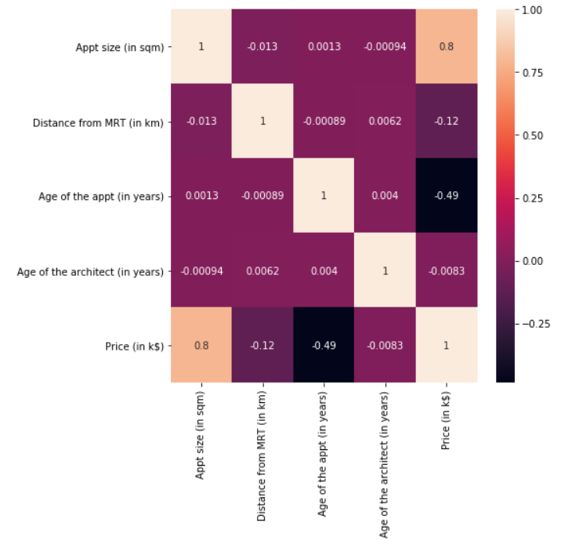

Slide 83
Correlation is not causation!
Important: Correlation is NOT causation!
Correlation is just an information about two data sets following the same trends.
It does not mean they will necessary be linked!
Tread carefully!

Slide 84
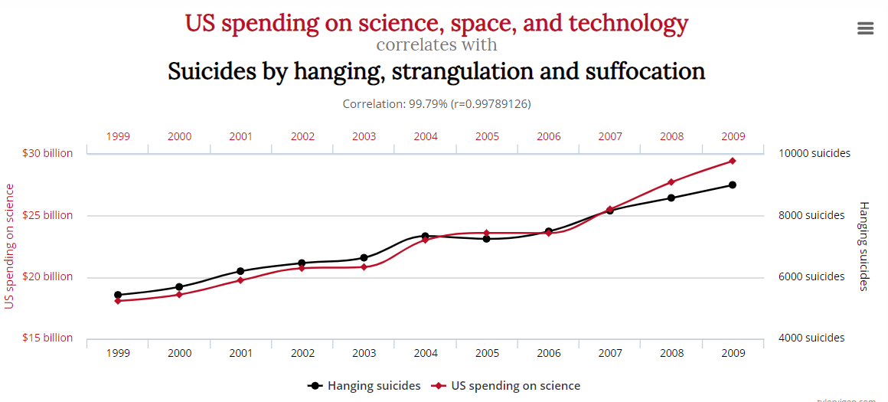
Correlation is not causation!
Source: http://www.tylervigen.com/spurious-correlations

Slide 85

Correlation is not causation!

Slide 86

Correlation is not causation!

Slide 87

Correlation is not causation!

Slide 88
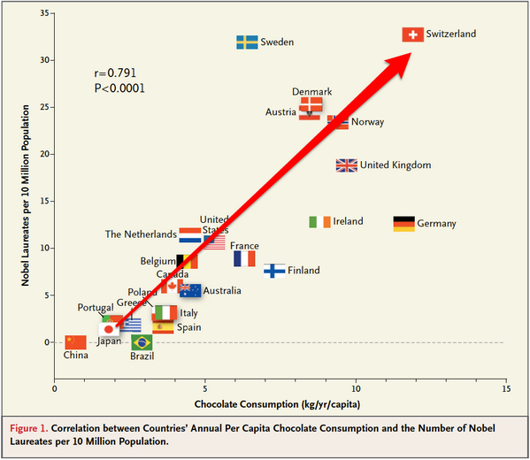
Correlation is not causation!

